Slide 1
iverilog installation

Slide 2
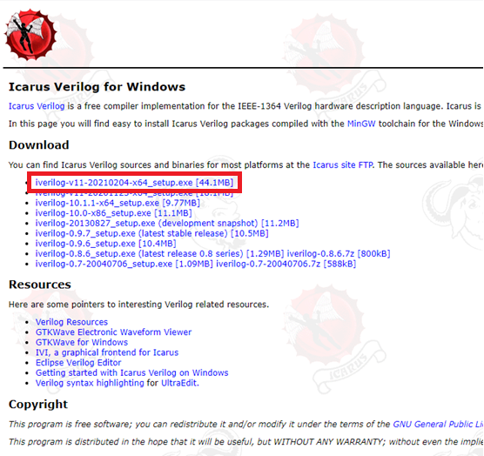
Download
http://bleyer.org/icarus/

Slide 3
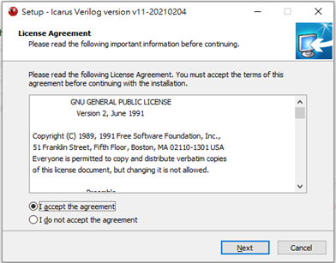

Slide 4
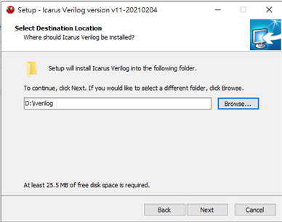
Choose the path you want
Ex: D:\

Slide 5
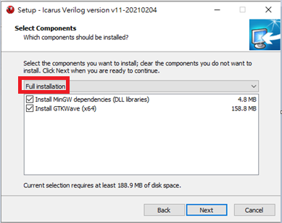
Full installation

Slide 6
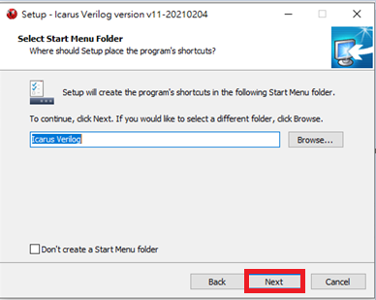

Slide 7
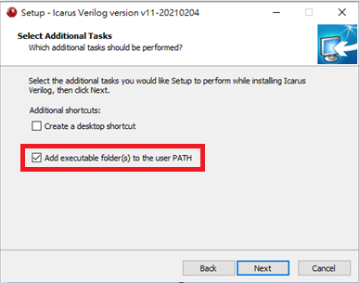
Important
Select → ADD executable folder(s) to user PATH
This will help you set up the Environment Variable

Slide 8
Restart your computer
After your installation is complete, please restart your computer
so that the environment variables will take effect.

Slide 9
Run your verilog program

Slide 10
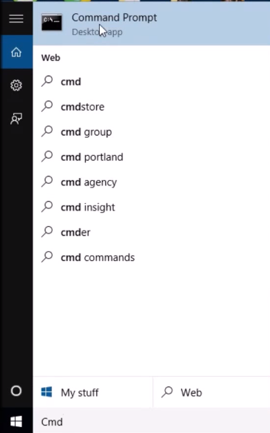
Windows cmd
Search cmd at search bar

Slide 11
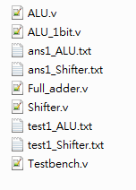
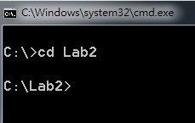
Change the directory in cmd
Ex: The path of my code is at C:\Lab2
(put all your code, test and ans data in same folder)

Slide 12
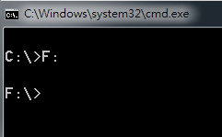
How to change the directory (folder) in CMD
change the directory
$ cd xxx
Ex: cd Lab2
change the drive
Ex: go to F:
$ F:
view the contents of a directory
$ dir

Slide 13
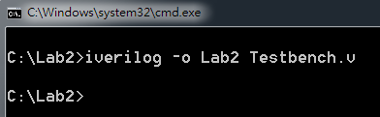
Compile your code
$ iverilog -o xxxx Testbench.v
xxxx is the output file name
Ex: Lab2

Slide 14
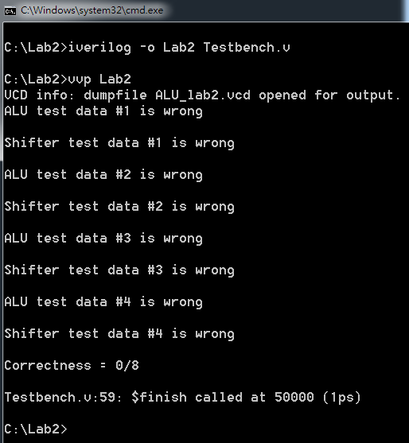
Run your code
$ vvp xxxx
execute the file xxxx you compiled
Ex: Lab2

Slide 15
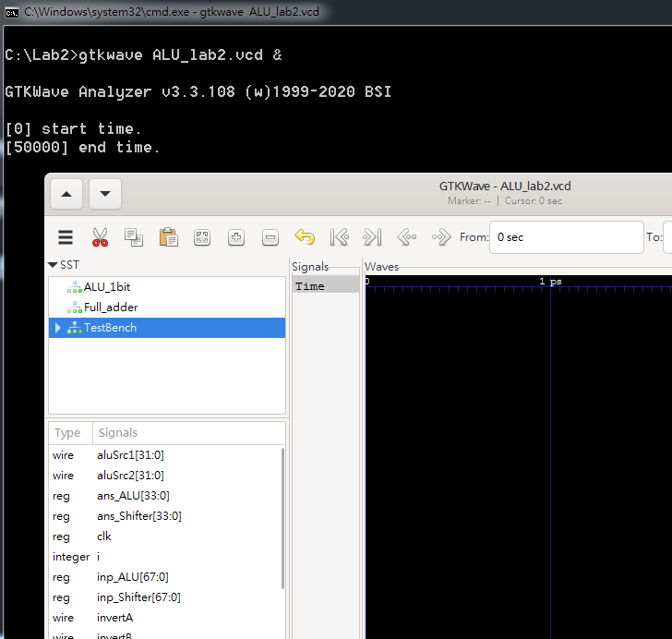
GTKWave
The code in Testbench.v will save the wave information in ALU_lab2.vcd
You can use gtkwave to check your wave if you need
$ gtkwave ALU_lab2.vcd &

